Slide 1


We can read sight words.

Slide 2

the

Slide 3

of

Slide 4

and

Slide 5
a

Slide 6

to

Slide 7
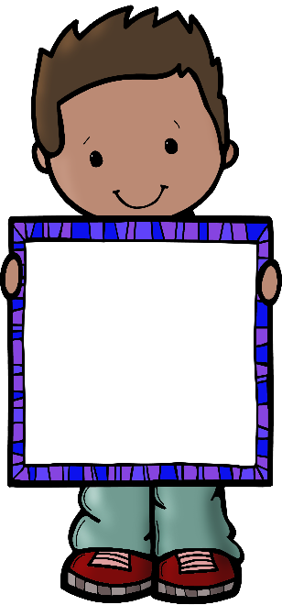
in

Slide 8
is

Slide 9

you

Slide 10

that

Slide 11

it

